Slide 1
COMPANY OVERVIEW
7x24 Exchange – SoCal Fall Meeting
Nov. 20, 2019
Damon Soulakis, Channel & Alliances

Slide 2
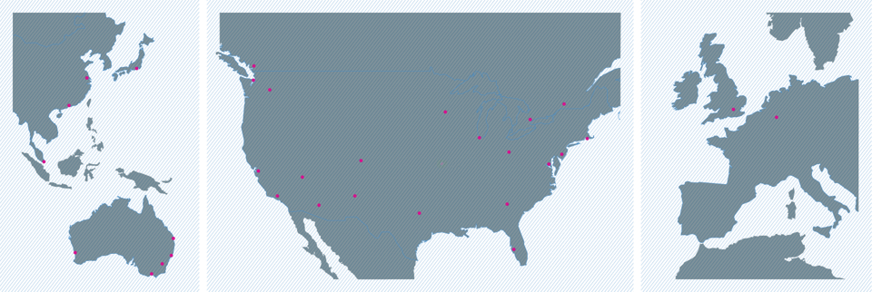

DIVERSE GLOBAL PRESENCE
TOKYO
VANCOUVER
SHANGHAI
SEATTLE
3
MOSES LAKE
AMSTERDAM
HONG KONG
MINNEAPOLIS
MONTREAL
LONDON
TORONTO
5
FRANKFURT
2
CHICAGO
BOSTON
3
3
COLOMBUS
NEW YORK METRO
SINGAPORE
DENVER
5
2
3
N. VIRGINIA
SILICON VALLEY
6
6
LAS VEGAS
LOS ANGELES
ALBUQUERQUE
3
PHOENIX
ATLANTA
2
DALLAS
2
BRISBANE
PERTH
SYDNEY
TAMPA
CANBERRA
MELBOURNE
58
29
2.9M
248
DATA CENTERS
MARKETS
SQUARE FEET
MEGAWATTS
Notes:
At its core, Cyxtera is a colocation company with a diverse global footprint of 50+ data centers. We offer a full range of colocation and connectivity services across 50+ facilities in 29 markets. Our track record of operational excellence and diverse ecosystem of network providers make us the provider of choice for discriminating customers that rely on our cost-effective yet reliable solutions.
In the world of cloud-first, however, we knew it was time for colocation to evolve. We’re excited to share with you today how Cyxtera is helping our customers address their cloud-first mandates in innovative and more cost-effective ways.
For new logos unfamiliar with Cyxtera and/or our colocation offerings:
Cyxtera was founded in May 2017 to deliver secure infrastructure for the modern enterprise. Our comprehensive portfolio meets the dynamic and distributed I.T. needs of over 3,500 customers worldwide, including global enterprises, leading service providers and federal government agencies. We’ve brought together a global data center platform with advanced cybersecurity to secure and support our customers’ systems and apps wherever they run.

Slide 3
NETWORK SERVICE PROVIDER ECOSYSTEM
600
140
14
40K
NETWORKS
NETWORK PROVIDERS
AVG NSP/FACILITY
CROSS CONNECTS
MASSIVELY CONNECTED
39
43
33
AZURE
AWS
GCP
DATA CENTERS WITHIN 3MS LATENCY OF PUBLIC CLOUDS
Notes:
Cyxtera is the third largest data center interconnection provider world-wide with more than 40,000 cross connects and counting…
All totaled, Cyxtera is host to over 600 network POPs worldwide
Our core markets now provide access to an average of 12 NPS per data center and across our global footprint we are averaging more than 10. This means that we have all of the major providers from local dark fiber providers to regional cable companies, national carriers, and cloud on-ramp providers.
We continue to grow our ecosystem of providers. In fact we’ve grown our network service provider ecosystem 26% in the past 12 months
Cyxtera’s broad footprint of data centers offer several cloud on-ramp options, so you have direct connections within just 3ms of any public cloud
Let’s see how our CXD and our Interconnection portfolio enable you make the connections you need across your distributed hybrid IT environment.

Slide 4


Interconnection
  Programmable and massively scalable
  Extend networks over distributed environments
  Ecosystem of global network providers
  Direct connect to cloud on-ramps
Infrastructure
  Colocation cabinets
  Compute infrastructure
  Storage platforms
  Pre-configured, easy to deploy and scale
“CXD is a novel approach to retail colocation, cloud-like in its flexibility.” CRAIG MATSUMOTO, SENIOR ANALYST
Notes:
That’s why we built CXD – The Cyxtera Extensible Data Center - to meet enterprise demand for a cloud agile private infrastructure platform.
As 451 Research analyst Craig Matsumoto highlighted in his Impact Report on CXD, we have taken a novel approach that makes traditional retail colocation more cloud-like in its agility but with all the cost, control, performance and security benefits of traditional retail colo.
The heart of CXD is the industry’s only programmable software-defined intra-data center network. This massively scalable interconnection platform enables you to seamlessly extend your existing VLANs to connect within our facilities, across a metro region, to low latency cloud on-ramps, an ecosystem of hundreds of network service providers.
Because we built this programmable fabric, we’re able to deliver and seamlessly connect dedicated infrastructure on-demand – from cabinets to compute options such as bare metal and HCI, and storage platforms – all pre-configured, easy to deploy and scale
Let’s take a closer look at our massively scalable, densely connected cloud and network provider ecosystem….

Slide 5
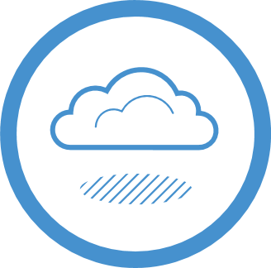



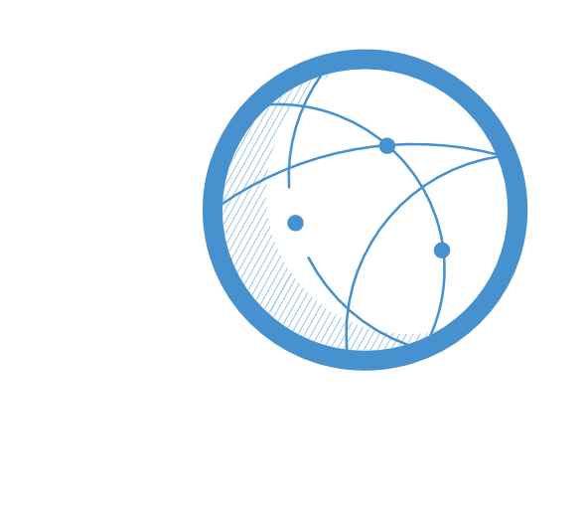

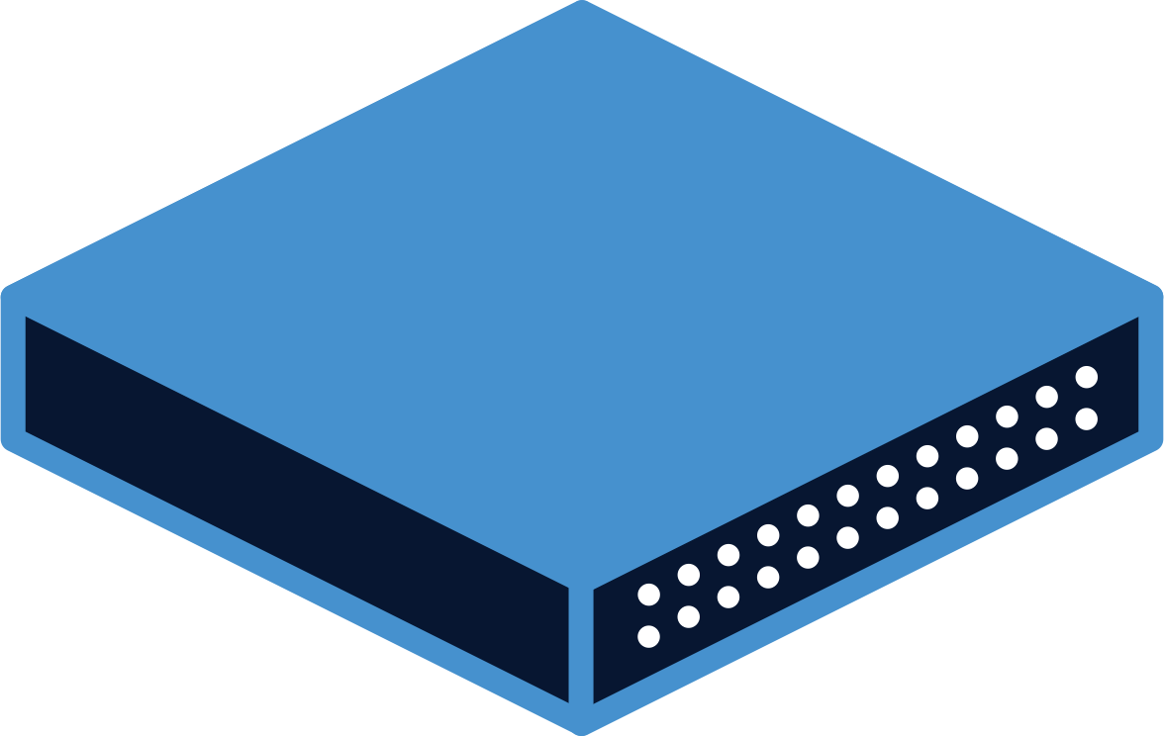

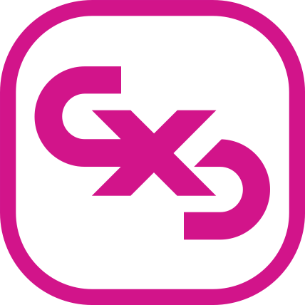
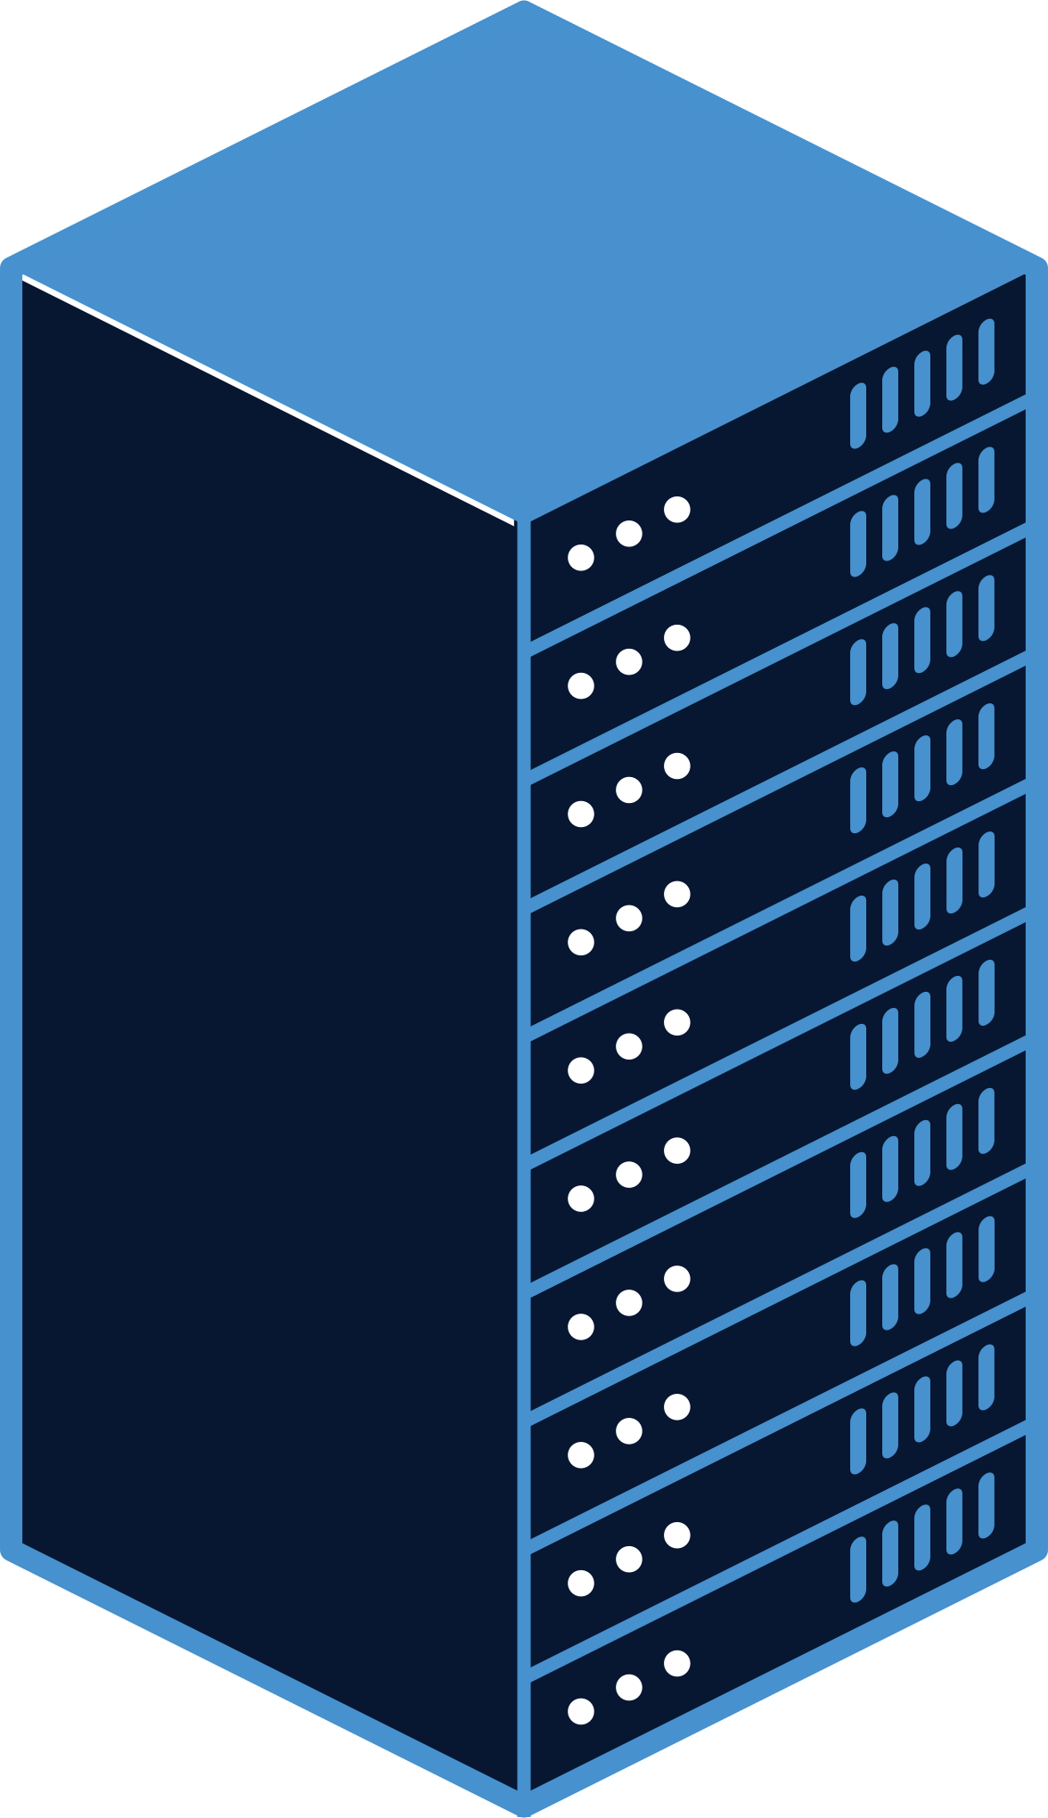
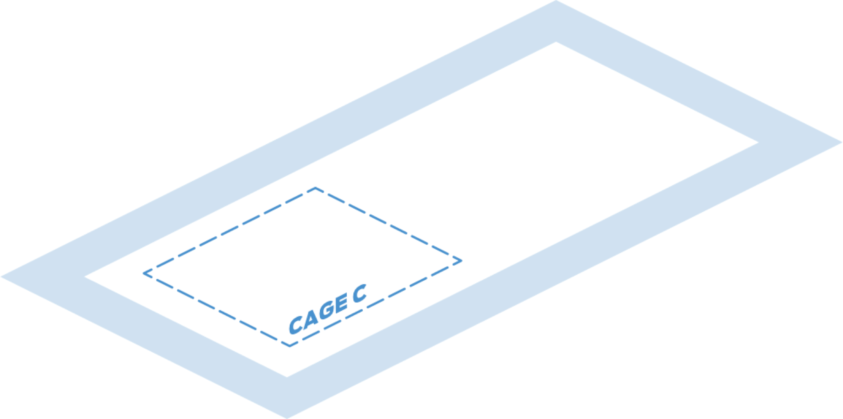

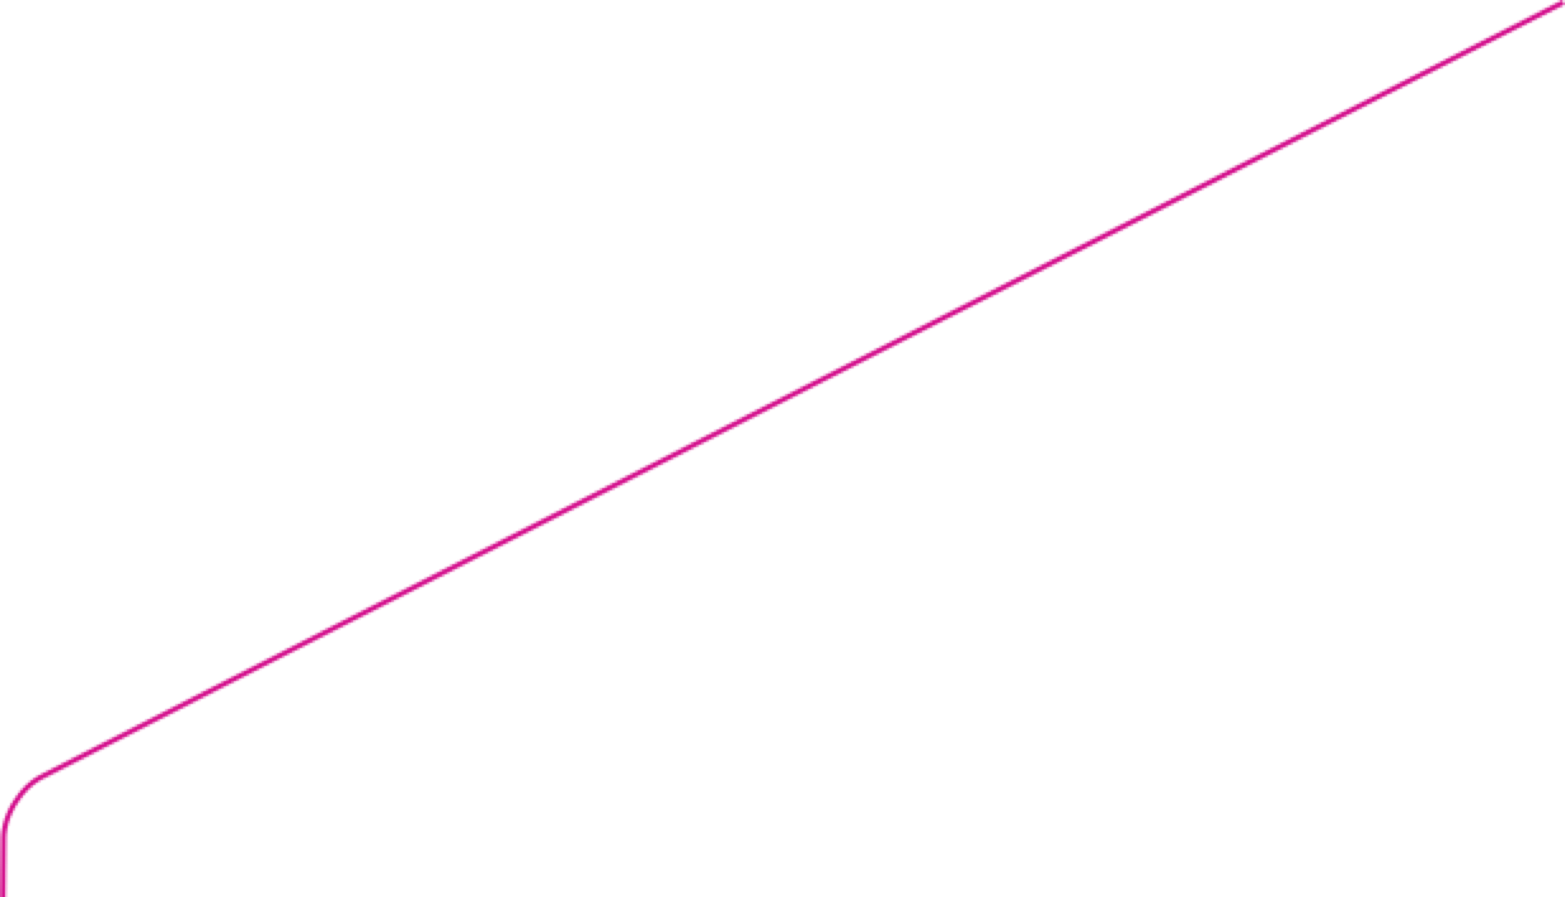

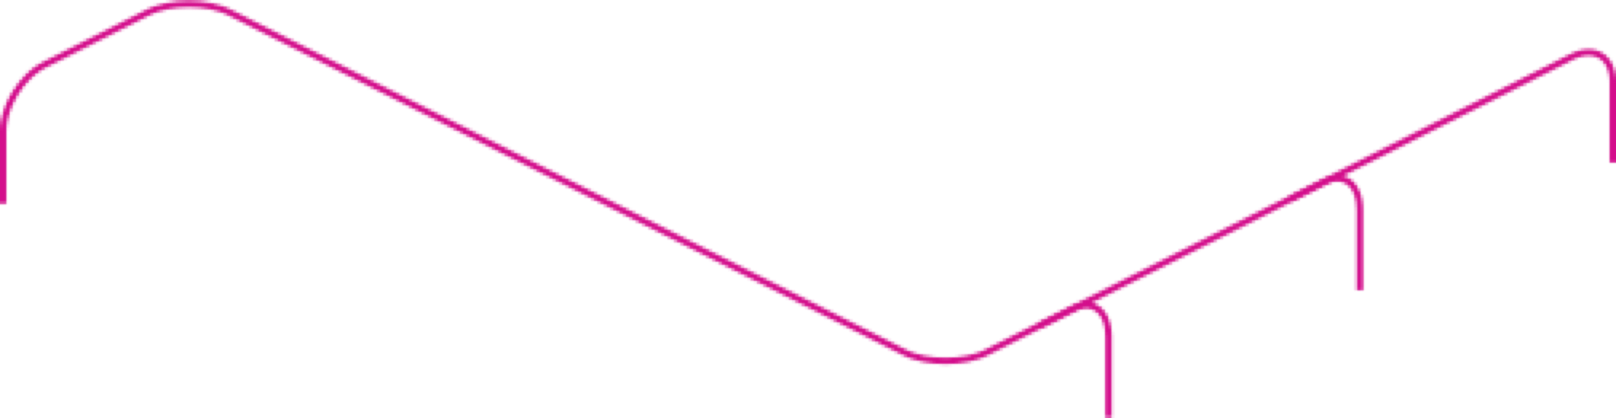

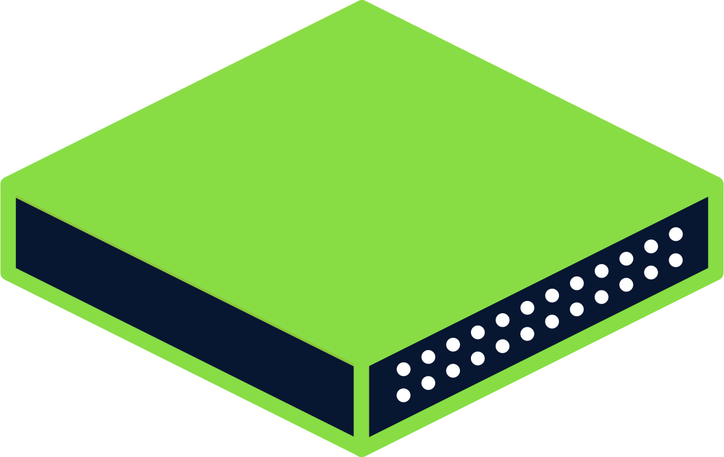
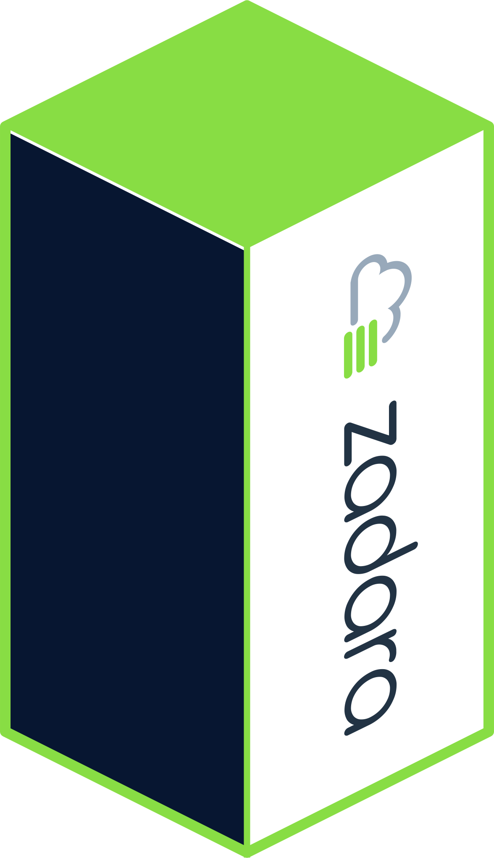
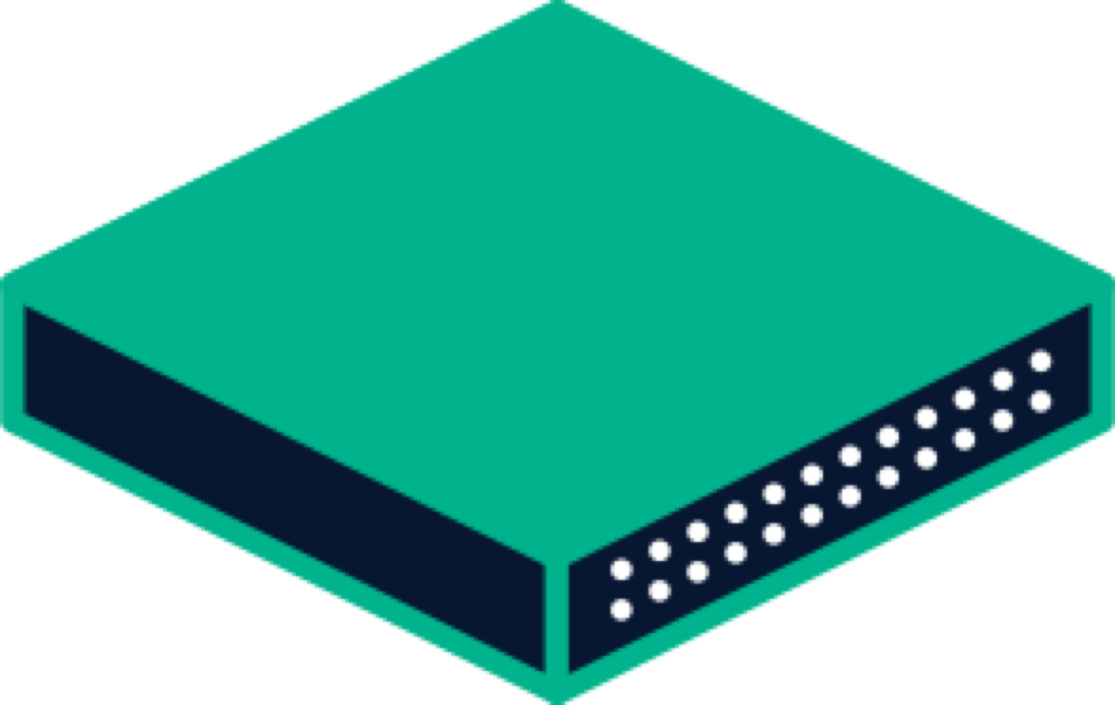
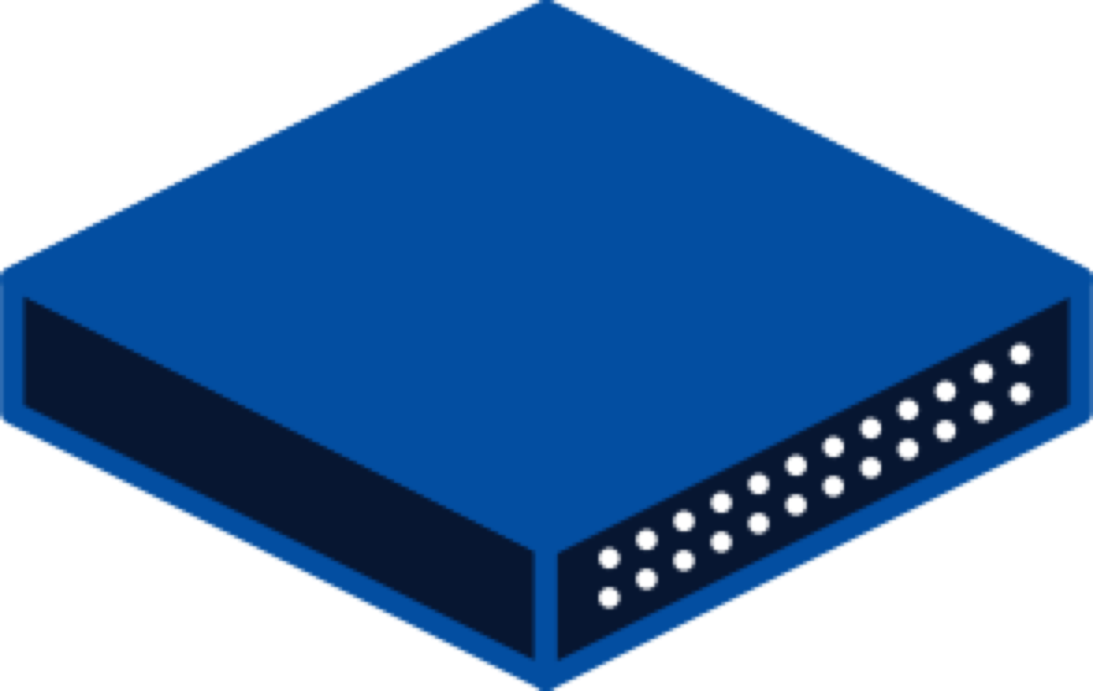
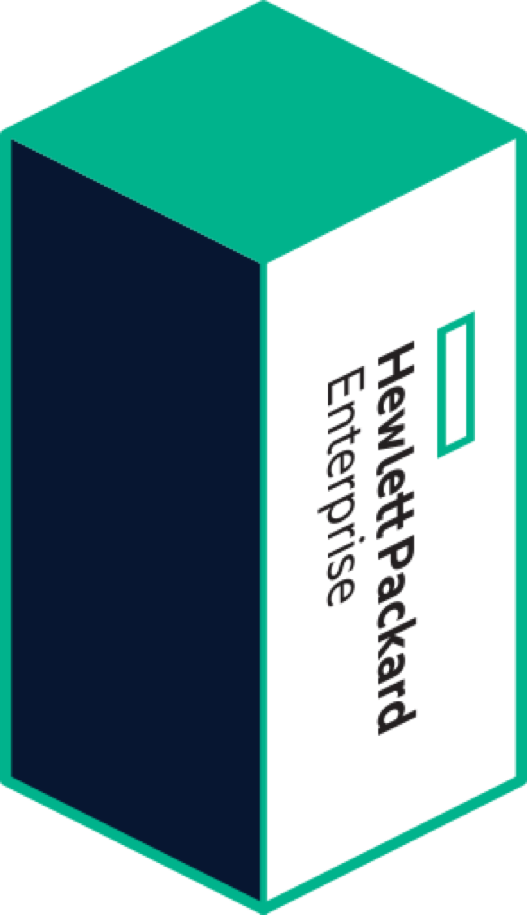
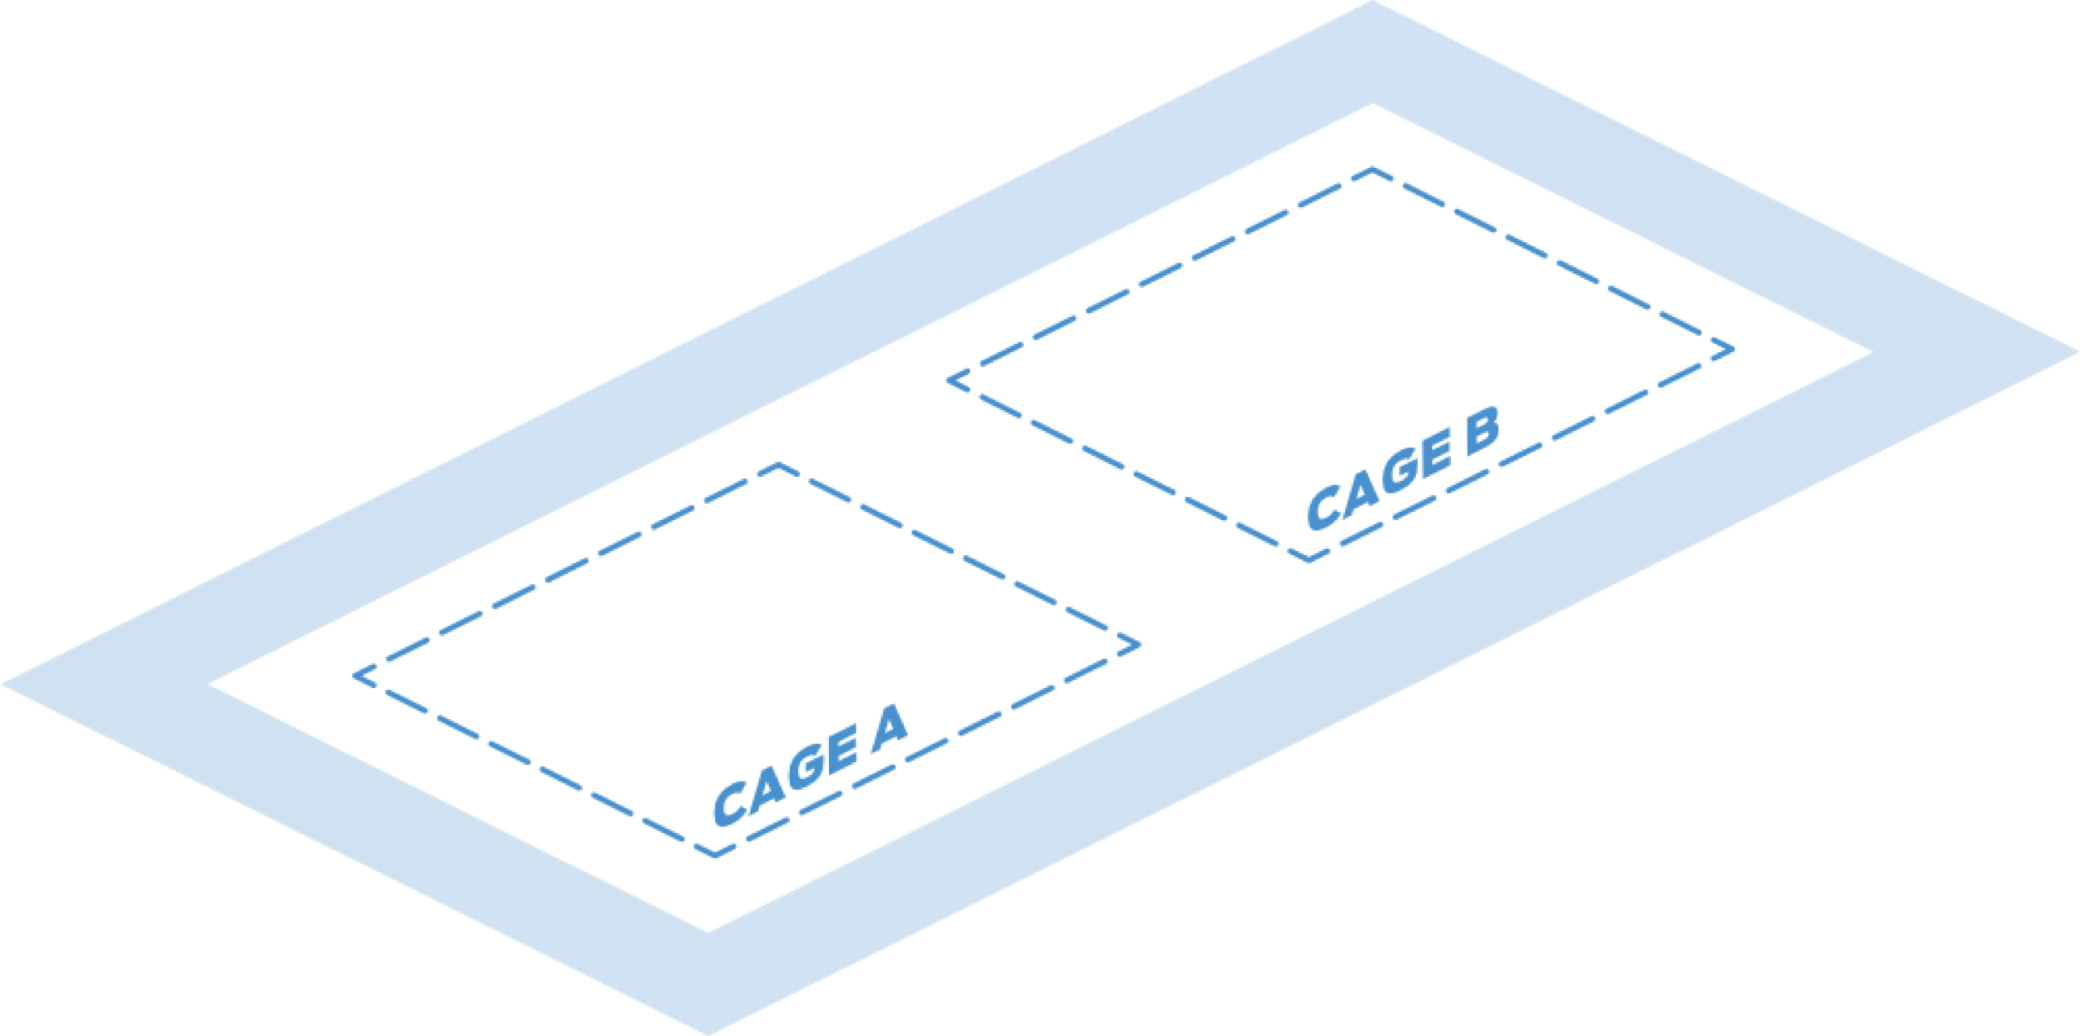
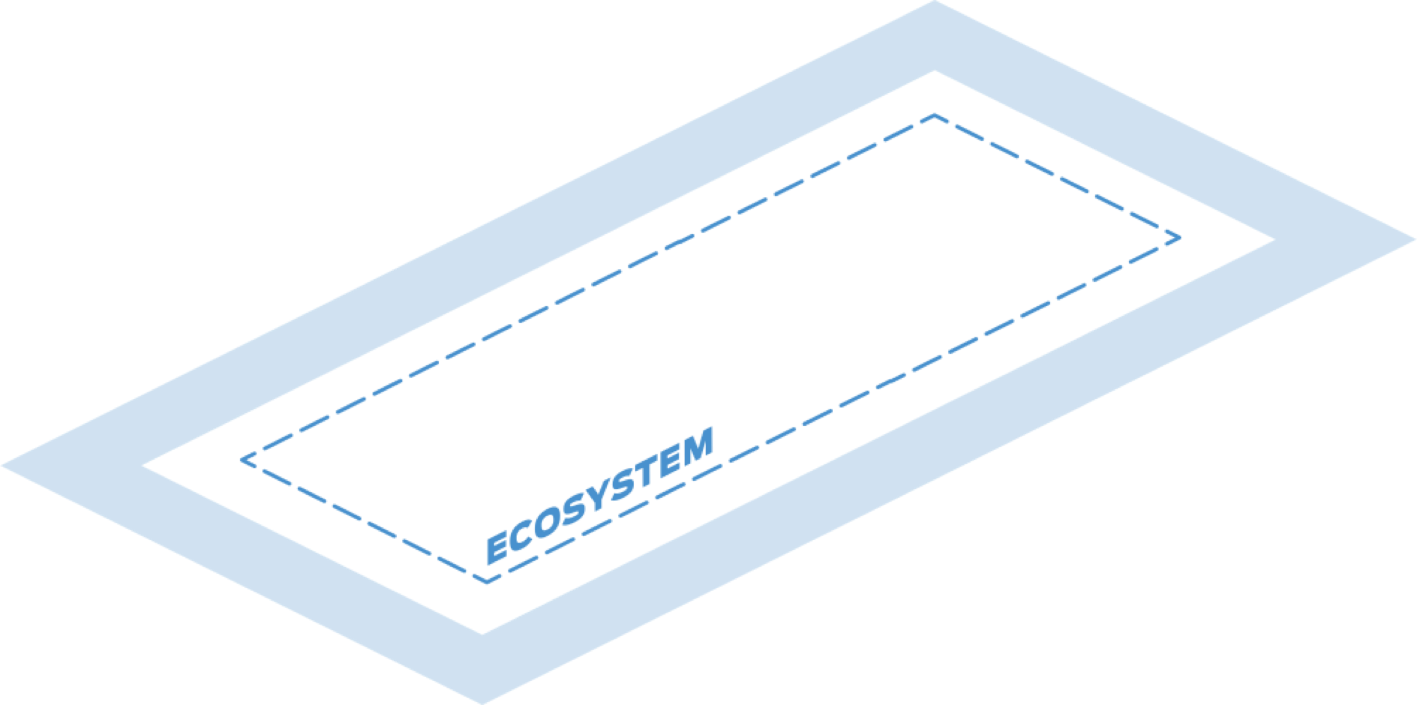
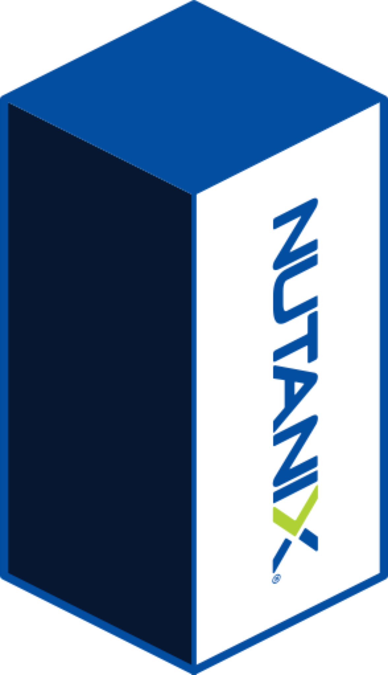


PUBLIC
CLOUDS
1
CLOUD
ON-RAMPS
NSP
INTERNET
Cross Connect
Connect within a facility
2
Metro Connect
Link infrastructure across metro data centers
2
3
3
1
Internet, Clouds & NSPs
Connect to blended IP bandwidth, cloud on-ramps and network providers
4
4
Services
Connect to an ecosystem of
service providers
Notes:
Imagine you’re a colo customer in one of our cages. You can point, click and create networks that easily link two more non-contiguous colocation spaces (cabinet / cage) on the same CXD-enabled Cyxtera data center campus. From the CXD portal you can connect these spaces and manage the logical VLAN networks with a keyboard and mouse rather than cable crimpers and patch cords.
.
<CLICK – Metro Connect>
Have deployments in multiple Cyxtera metro area data center campuses? Or want to access a service provider running in your metro area? Use CXD Metro Connect to extend secure layer 2 networks to manage them as a single virtual environment. You don’t have to wait (or pay for) a network provider to PoP into your facility – leverage our secure metro ring to access network provider PoPs in the other data center in the same metro.
<CLICK – Clouds & NSPs>
Nearly every IT infrastructure deployment requires Internet and cloud connectivity. With CXD’s blended IP transit service (IP Connect) you can rapidly deploy and control of reliable Internet connections via API or web console. [Combine IP Connect with Cyxtera’s AppGate SDP to create a secure remote access solution to your colocation space.]
You can connect to your choice of low-latency cloud on-ramps and network providers. Connections to your WAN can be made without the weeks of delay associated with traditional circuit provisioning (note this service is under development).
<CLICK –SERVICES>
CXD’s on-demand network even enables fast and seamless connectivity to a portfolio of CXD-enabled HW, SW, and 3rd party services.
Before we show you a live demo, let’s quickly walk through how easy it is to point, click and provision colocation on-demand.

Slide 6
LAX3 Tour Logistics
7x24 Exchange – SoCal Fall Meeting
Nov. 20, 2019
Monica Smith, Social and Events Marketing Manager

Slide 7
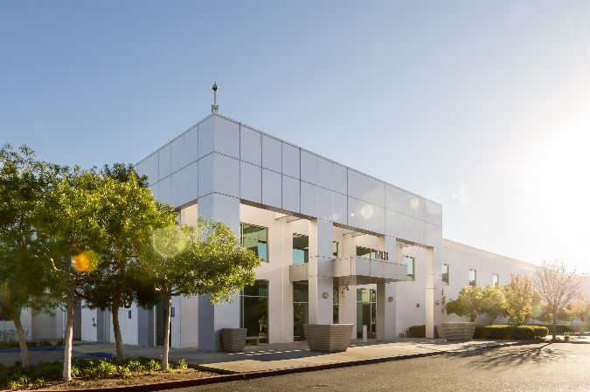
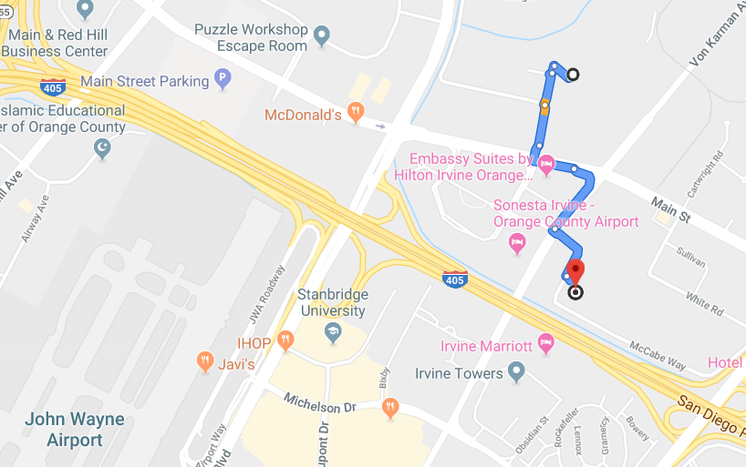
LAX3 Tours
Government Issued ID w/ Photo
No food or beverage
30-minute tour
Shuttle bus
Sign-up at registration desk
Group A
Leave Venue 5:45
Arrive Cyxtera 5:50
Return to Venue 6:00
Group B
Leave Venue 6:05
Arrive Cyxtera 6:10
Return to Venue 6:20
Group C
Leave Venue 6:25
Arrive Cyxtera 6:30
Return to Venue (with Group A) 6:40
Return trips:
Leave Venue 6:45
Arrive Cyxtera 6:50
Return to Venue (with Group B) 7:00
Arrive at Cyxtera 7:10
Return to Venue (with Group C) 7:20
Distance to LAX3 = 0.7 miles
5-minute shuttle ride

